Slide 1
3D Geometry Multi-View Stereo Reconstruction
Sprint 1 - Group 18: Rao, Hongyi
Wang, Jiahao
Zhang, Yiqin

Slide 2
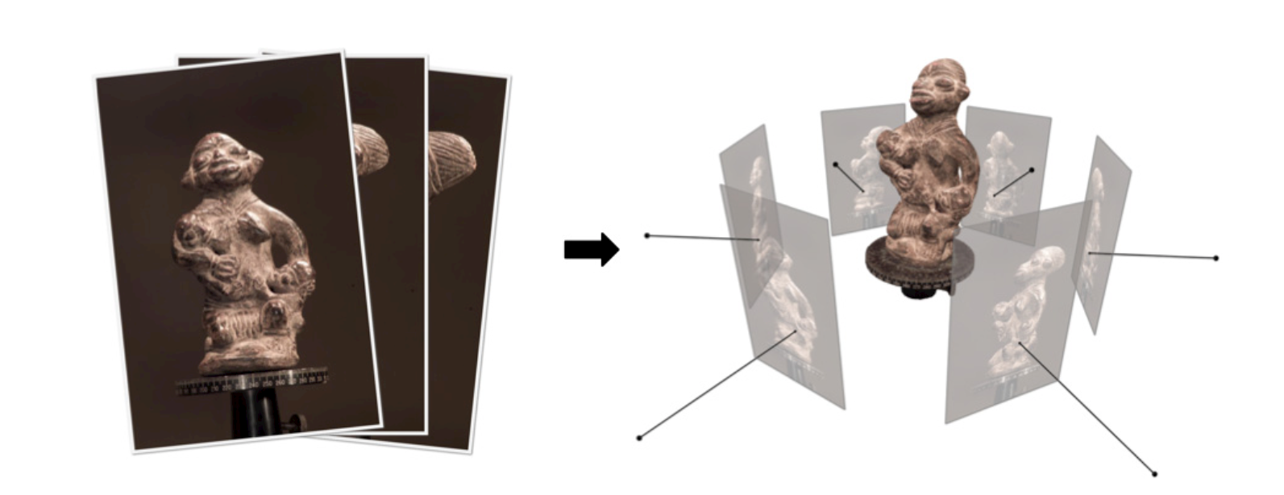
Multi-View Stereo (MVS)
Multi-view stereo (MVS) is a general term for a series of methods of multi-view 3D reconstruction which refers to the task of reconstructing a 3D shape from calibrated overlapping images captured from different viewpoints.
It uses multiple photos taken by one/multiple cameras to reconstruct the 3D scene in the picture.
Notes:
Multi-view stereo (MVS) is a general term for a series of methods for 3D reconstruction.
The task is reconstructing a 3D shape from calibrated overlapping images captured from different viewpoints.
Multi-view stereo (MVS) uses multiple photos taken by one/more cameras to reconstruct the 3D scene in the picture.

Slide 3
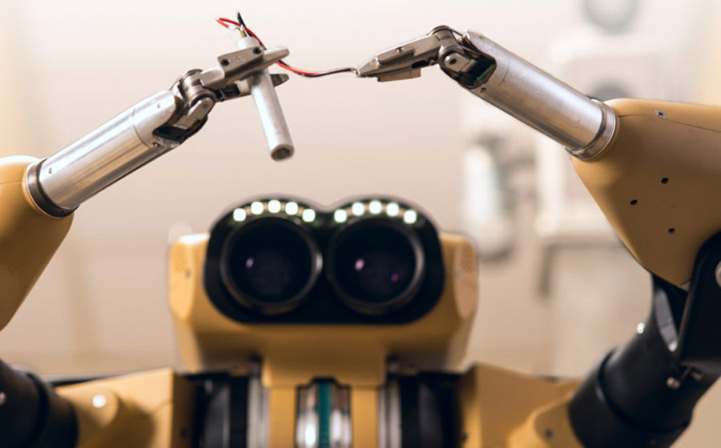
Applications of MVS
3D mapping and navigation
Online shopping
3D printing
Computational photography
Computer video games
Cultural heritage archival.
In robotics, MVS can obtain the position and posture of an object through a single camera to assist the grasping of the robotic arm.
Notes:
MVS is widely used range from 3D mapping and navigation to online shopping, 3D printing, video games, or cultural heritage archival. In robotics, MVS can obtain the position and posture of an object through a single camera to assist the grasping of the robotic arm.

Slide 4
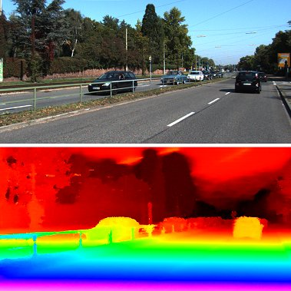
In autonomous driving, MVS can more accurately generate models of nearby objects to assist obstacle avoidance.
Notes:
In autonomous driving, MVS can generate models of nearby objects to assist obstacle avoidance.

Slide 5
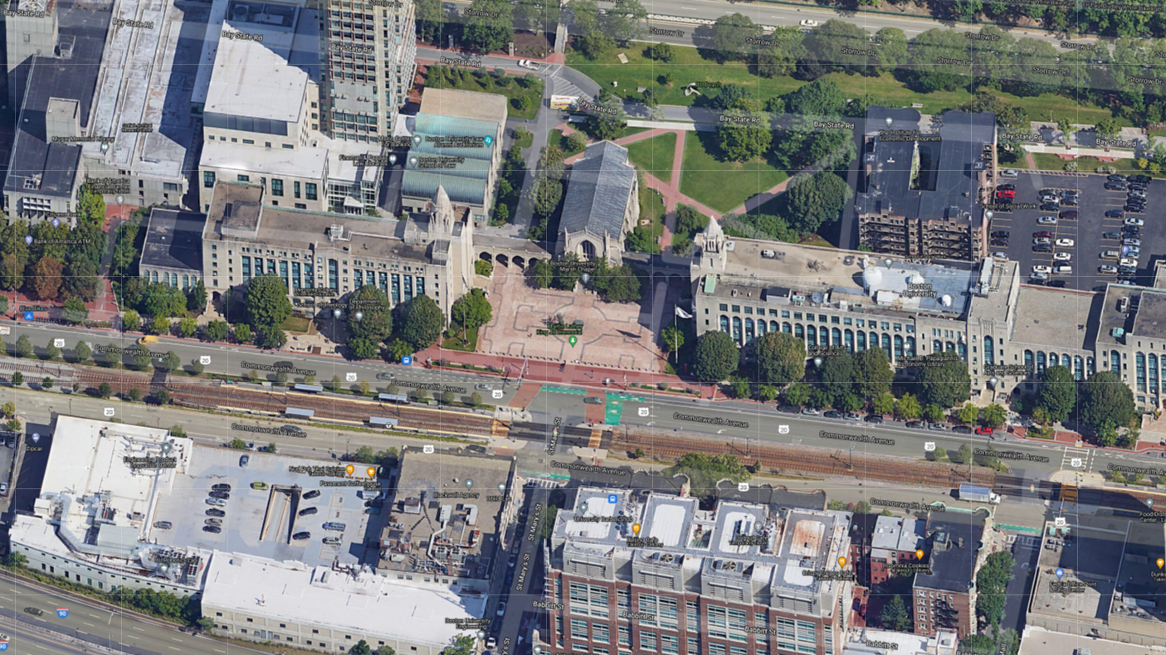
MVS can effectively reconstruct metropolises and rural areas, processing millions of photos over hundreds of kilometers at a time.
Apple Maps “Flyover” feature provides views of high quality texture mapped city building models.
Google Maps “Earth View” also provides stunning 3D views of cities.
Notes:
MVS can effectively reconstruct cities. For instance, Apple Maps' "Flyover" feature and Google Maps "Earth View" provide 3D views of texture-mapped city building models.

Slide 6
Mission:
Reconstruct a complete 3D object model from a collection of images taken from multiple camera viewpoints.
Notes:
The mission is to reconstruct a complete 3D object model from a collection of images taken from known camera viewpoints.

Slide 7
Literature Review

Slide 8
MVS - Traditional method
The MVS algorithms have improved over the past few decades with two breakthroughs: the improvement of digital cameras and computing power. It can be divided into two categories:
Traditional hand-crafted method
Modeling method based on deep learning after 2015.
1. Handcrafted Cost Metric
Sum of Squared Differences(SSD)
Normalized Cross Correlation(NCC)
2. Engineered Cost Regularization
Propagation
Semi-global Matching(SGM)
Notes:
As the improvement of digital cameras and computing power, The algorithms improved over the past few decades. It can be divided into two categories. One is the hand-crafted traditional method, and the other is the modeling method based on deep learning after 2015.

Slide 9
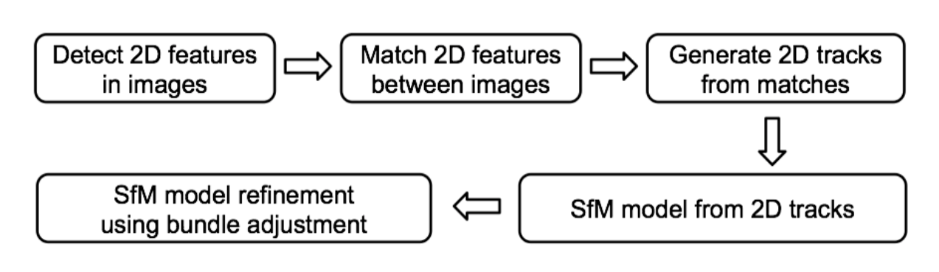
SFM (Structure from motion)
SFM(Structure for motion) algorithm: a series of algorithms for estimating three-dimensional structure from a sequence of moving two-dimensional images.
Four steps: finding features, matching features, generating trajectories, and modeling trajectories.
Notes:
SFM(Structure for motion) algorithm refers to estimating 3D structure from a sequence of moving 2D images.It is valuable for MVS reference.

Slide 10
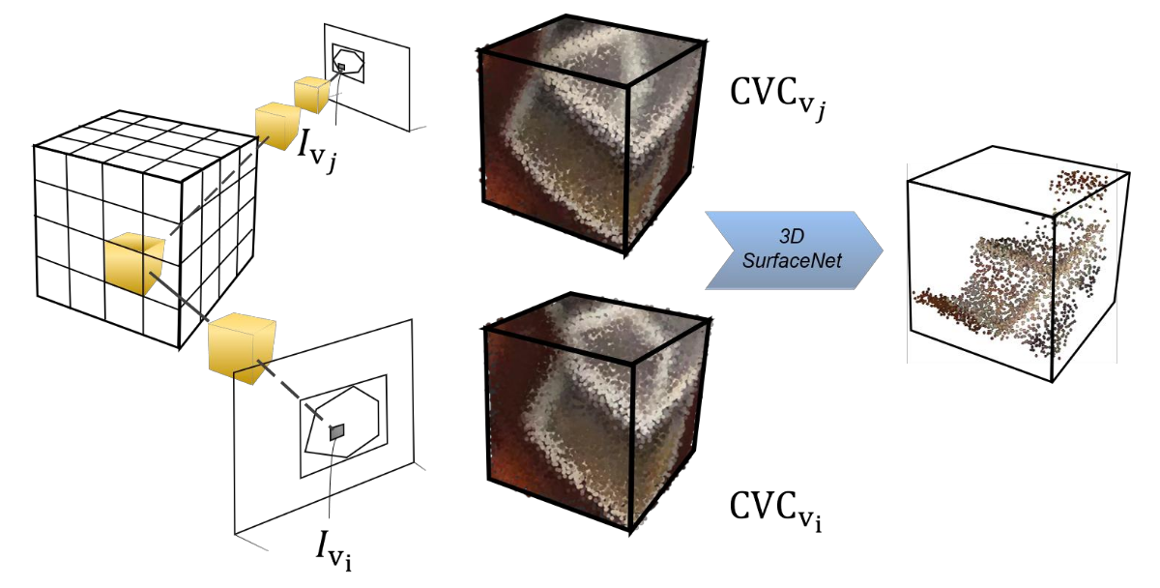
Modeling method
based on deep learning
SurfaceNet - 1st learning based pipeline
constructs the Colored Voxel Cubes (CVC) in advance, which combines all image pixel color and camera information to a single volume as the input of the network.
Uses 3D CNN to regularize and infer the surface voxels.
Notes:
The 1st deep learning based pipeline for MVS problem is SurfaceNet
It pre-computes the cost volume with Colored Voxel Cubes,
and uses 3D CNN to regularize and infer the surface voxels.

Slide 11
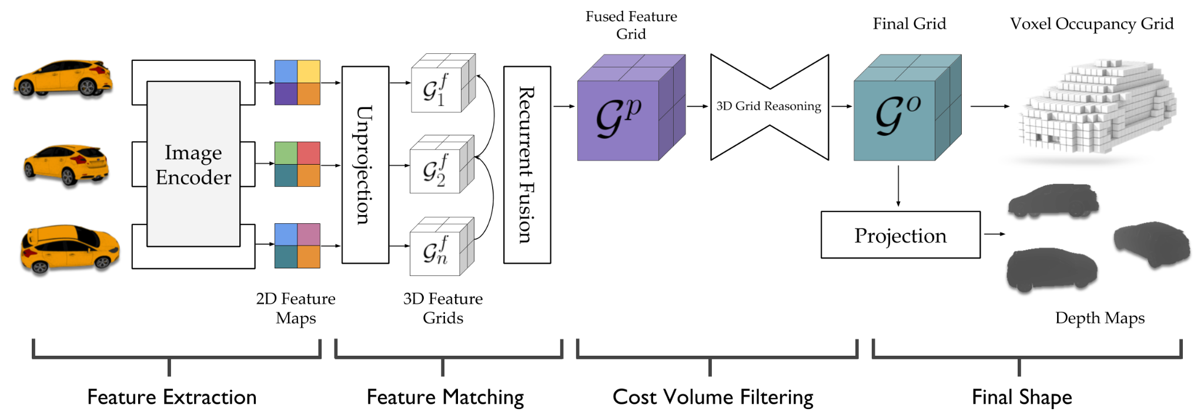
Modeling method based on deep learning
Learned Stereo Machine (LSM) directly leverages the differentiable projection/unprojection to enable the end-to-end training/inference.
Camera parameters are encoded in the network as the projection operation to form the cost volume, and 3D CNN is used to classify if a voxel belongs to the surface.
Notes:
The most related approach to ours is the LSM. In LSM Camera parameters are encoded in the network as the projection operation to form the cost volume, and 3D CNN is used to classify if a voxel belongs to the surface.

Slide 12
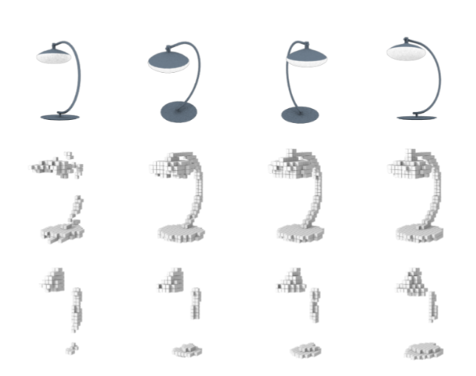
Drawback
SurfaceNet and LSM are restricted to only small-scale reconstructions due to volumetric representation of regular grids.
Notes:
The essence of an image is a projection from a 3D scene onto a 2D plane, during which process the depth is lost.

Slide 13
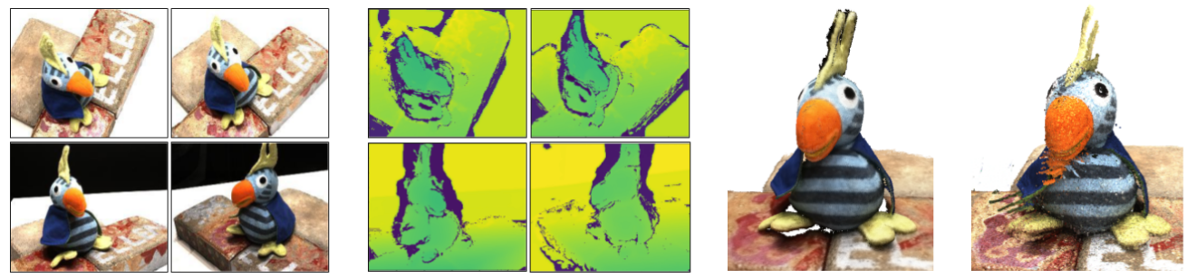
MVS Reconstruction
There are three main types of data formats in 3D reconstruction.
1) direct point cloud reconstructions
2) volumetric reconstructions
3) depth map reconstructions
Input images Predicted depth maps 3D reconstruction point cloud
Notes:
2D images do not give us enough information to reconstruct a 3D scene because image points are the actual objects' projections on a 2D plan without depth.

Slide 14
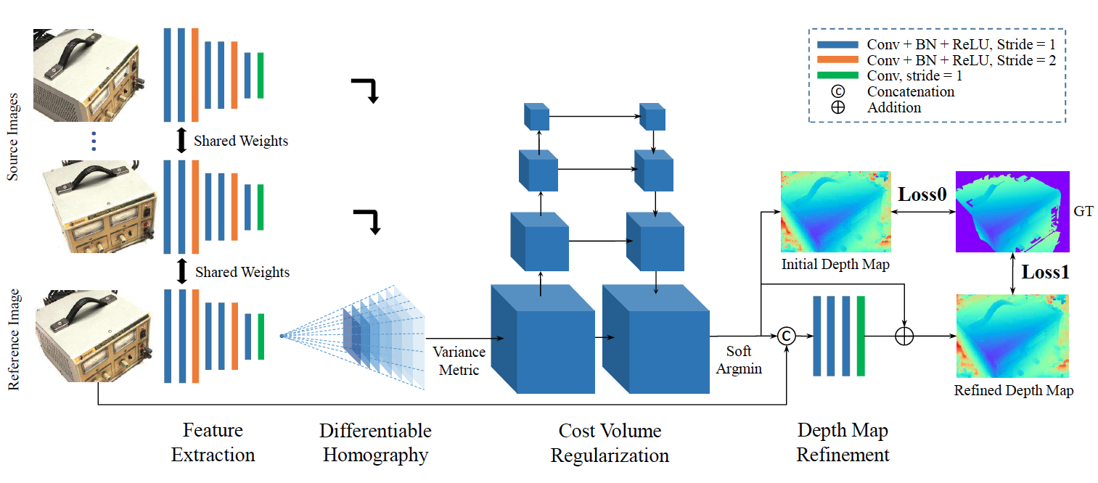
MVSNet
End-to-end MVS learning framework
Camera geometry encoded as differentiable homography
Variance-bacd Cost Metric for N-view similarity
Notes:
MVSNet is the method we are working on. It's an End-to-end MVS learning framework.
MVSNet takes one reference image and several source images as input, infers the depth map for the reference image, and then uses the convolutional network to obtain the feature maps.
The key insight here is the differentiable homography warping operation. It implicitly encodes camera geometries in the network to build the 3D cost volumes from 2D image features.
Variance-based metric maps multiple features into one cost volume. It makes it possible to adapt an arbitrary number of source images in the input.

Slide 15
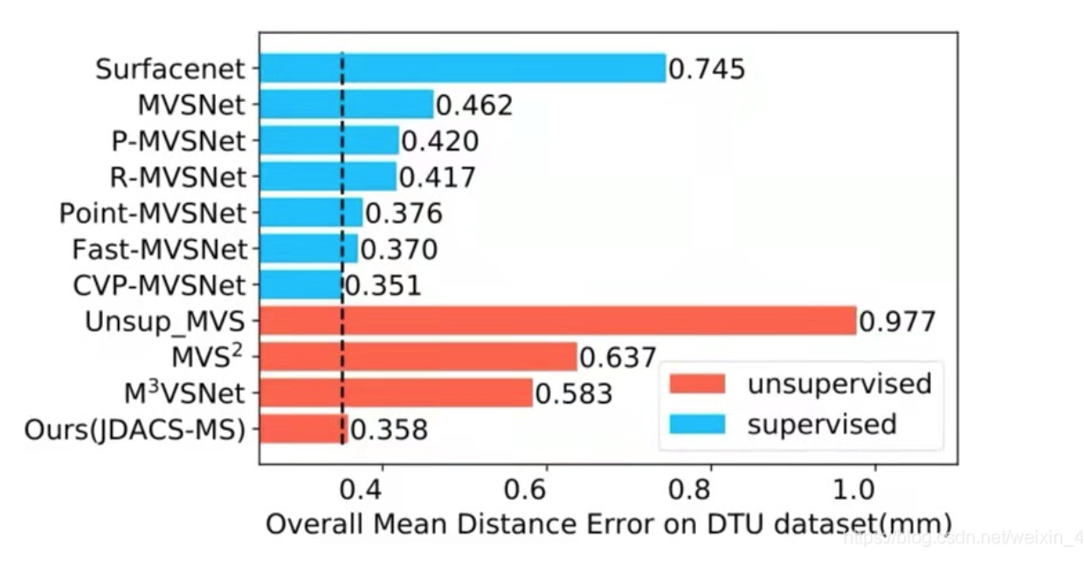
Afterward, many researchers proposed improved versions on MVSNet, such as R-MVSNet, Fast-MVSNet, and Cas-MVSNet.
The best method today is CVP-MVSNet based on neural networks.

Slide 16
Open Source Project
PMVS
MVE
OpenMVG
mature open source MVS software (2007)
Multi-View Environment
Multiple View Geometry
Takes a set of image and camera parameters, and then reconstructs 3D structure of the object or scenes visible in the images
Complete end-to-end pipeline for image-based geometry reconstruction
3D reconstruction from images by developing a C++ framework.
extensively used by nonexperts such as artists and civil engineers
constantly updated, such as PMVS2, CMVS, etc.
Has the functions of SFM, MVS and Surface Reconstruction.
Written in C++ and comes with a set of efficient, cross-platform and easy-to-use libraries
Includes the two complete SfM pipelines.
Provides customizable tools to help engineers to deal with MVS problems.
Notes:
PMVS is probably the first successful open source MVS software (2007), which has been extensively used by nonexperts such as artists and civil engineers. PMVS is a multi-view stereo software that takes a set of image and camera parameters, and then reconstructs 3D structure of the object or scenes visible in the images. It is now a relatively mature open source product, and constantly updated, such as PMVS2, CMVS, etc.
The Multi-View Environment is an implementation of a complete end-to-end pipeline for image-based geometry reconstruction. It has the functions of SFM, MVS and Surface Reconstruction. MVE is written in C++ and comes with a set of efficient, cross-platform and easy-to-use libraries.
OpenMVG's mission is to extend awareness of the power of 3D reconstruction from images by developing a C++ framework. The library also includes the two complete SfM pipelines and provides customizable tools to help engineers to deal with MVS problems.

Slide 17
MVP & User Stories

Slide 18
MVP
Small objects.
Import: a series of photos (more than TWO) from different angles of the same object.
The definitions of the photos are the same. No limit on size and format theoretically.
The difference from before: No camera information (pose, and internal reference) is required.
Export: 3D models can be seen on the software and can export to 3D model files.

Slide 19
User Stories
Assisted Modeling Tool.
Help reduce modeling time and modify details based on the draft model.
Notes:
Our goal is to create an Assisted Modeling Tool.
Help reduce modeling time and modify details based on the draft model.

Slide 20
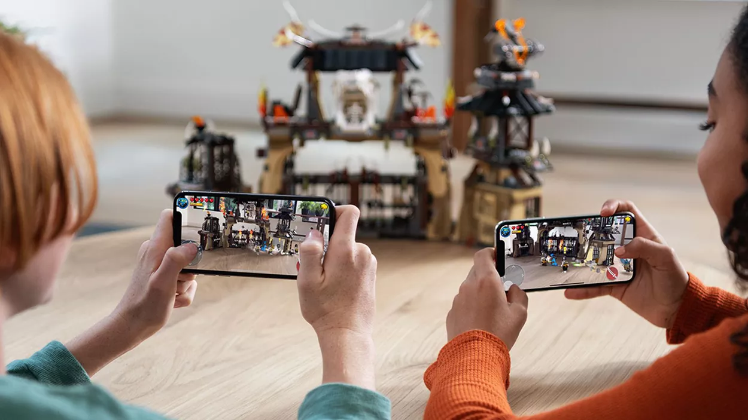
As a game developer
I want to quickly create many small objects/props in batches, enriching the scene without requiring high precision.

Slide 21

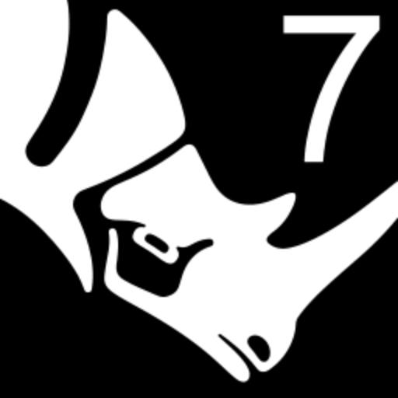



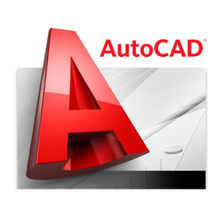



As a product designer
I want to reduce tedious modeling time dramatically.

Slide 22
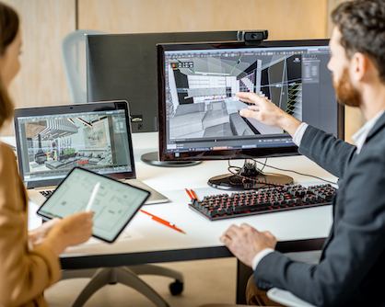
As a designer
I want to illustrate my initial design ideas conveniently and efficiently.
Modify and polish initial design ideas based on the draft model.

Slide 23
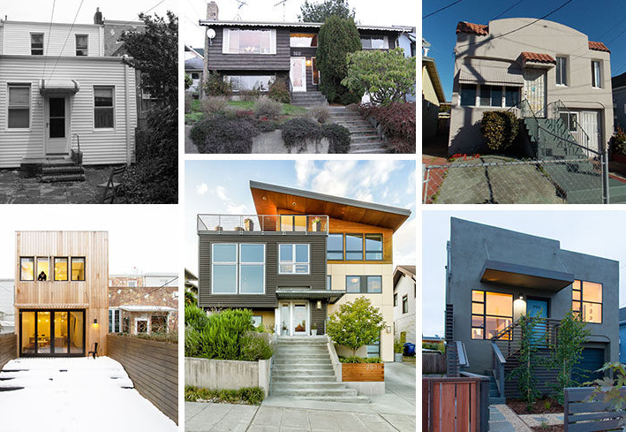
Before
As an architect,
I want to show comparative effect before and after building renovations to my clients promptly.
After

Slide 24
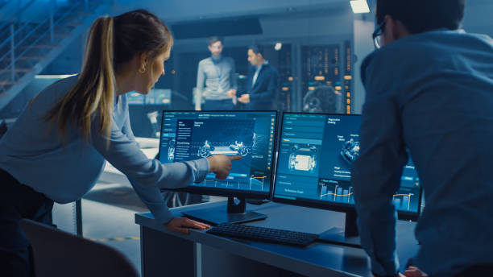
As a manager
I want to
Provide reference model and modify suggestions efficiently.
Improve design solutions and advance project progress.

Slide 25
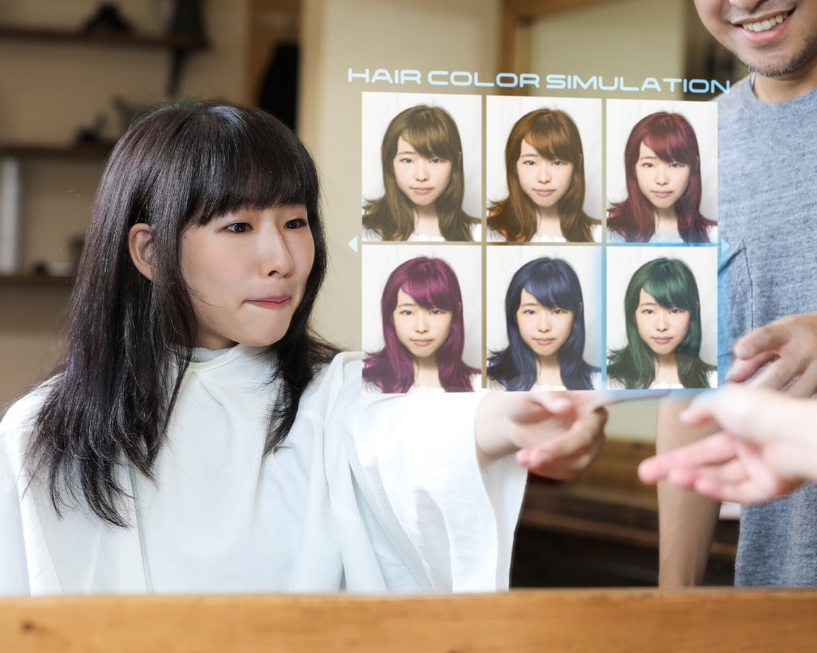
As a customer
I want to try different hairstyles and colors to choose the one that suits me best.
when I go shopping online, I want to try on the glass and makeup virtually.

Slide 26

As a house owner
I want interior designers to showcase the material and samples in a rendering model of my house instead of a sample board.

Slide 27
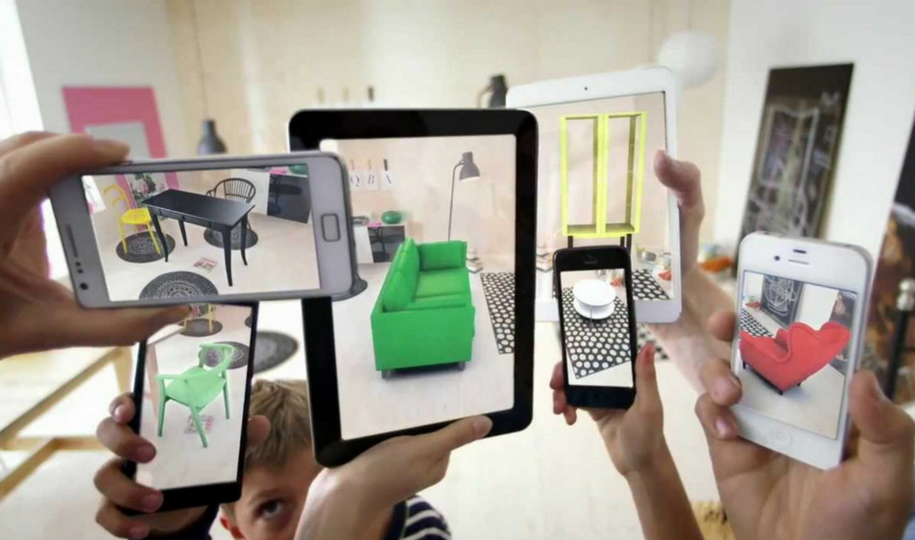
As a house owner
I want to show my favorite design styles to interior designers and give them my preference.

Slide 28
Technologies
Notes:
Technologies

Slide 29
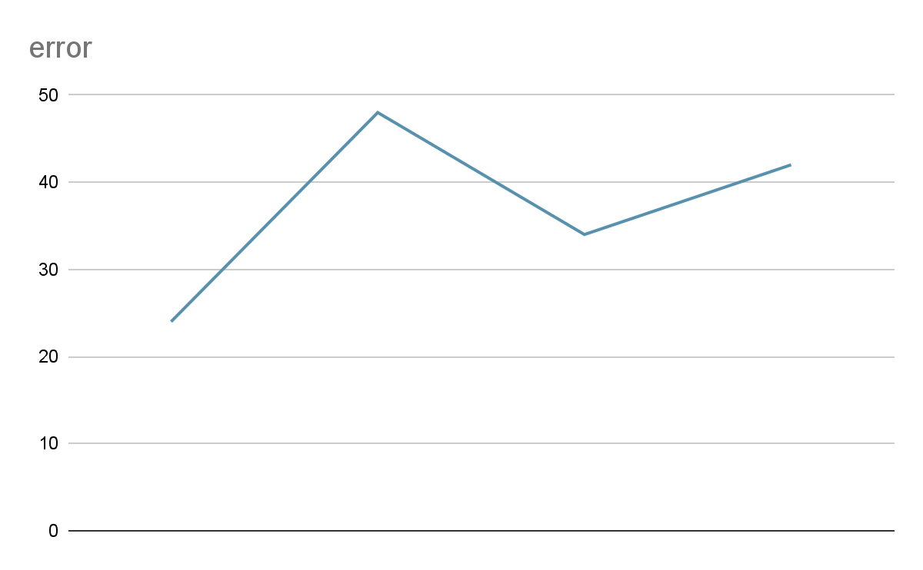

Technologies to evaluate
Compare the performance of our Model with PMVS, MVE, OpenMVG

Slide 30
Development Environment
Github for version control and publishing
Deep learning on Python
Pytorch/ Tensorflow
UI framework. PyQt5
SCC

Slide 31
Road map
10/12/21
10/25/21
11/08/21
11/29/21
12/08/21
12/15/21
Sprint 1
Sprint 2
Sprint 3
Sprint 4
Sprint 5
Sprint 6
MVP & User Stories
Constructing algorithm. Model selection
MVS algorithm implement.
Software implement
Software improvement. Test user cases
Poster Presentation.
Notes:
Definition of architecture
Technology Selection and justification
Functional demonstration of major user story

